Slide 1




HackOrbit 2025
Innovators

Slide 2

THEME & PROBLEM STATEMENT
Theme: AI in Healthcare | Ayurveda | Wellness Tech
Problem Statement: In today’s fast-paced digital world, many individuals overlook holistic well-being, relying heavily on synthetic treatments. There's a lack of easy access to natural, personalized Ayurvedic remedies and wellness tools that blend ancient knowledge with modern interfaces. Can we create a lightweight, AI-aided, interactive Ayurvedic health assistant that’s accessible, multilingual, and works even without complex cloud setups?

Slide 3
PROPOSED SOLUTION
AyuCare is a web-based Ayurvedic Health Assistant offering:
->AI-powered health bot to suggest natural remedies based on symptoms.
->Plant scanner using a camera.
->Categorized library of remedies, food tracker, and personal health journal.
->Yoga, meditation, and Ayurvedic product recommendations.
->Built using lightweight tech – no backend server or database required.

Slide 4
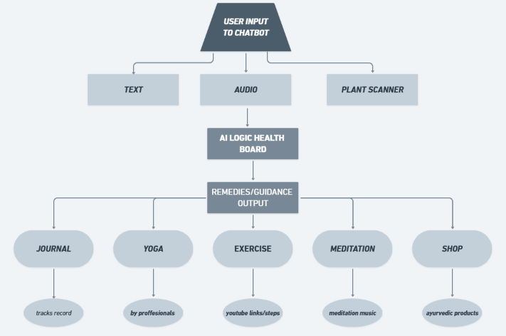
FLOWCHART

Slide 5
FLOWCHART
User Input → (Text / Voice / Camera) → AI Health Logic (JSON-based) → Remedies or Guidance Output → User Logs it in Journal or Tracker → User receives Notifications & Alerts

Slide 6
FEATURES AND NOVELTY
🔹 Voice Input for chat bot
🔹 Camera-Based Plant Scanner
🔹 Personalized Ayurvedic Remedies Library
🔹 Emergency First-Aid Suggestions (Fever, Cuts, Coughs, etc.)
🔹 Food & Lifestyle Tracker (Ritucharya-aligned)
🔹 Personal Journal for Health Logs
🔹 Yoga, Meditation, and Joint Exercises with Visuals
🔹 Fully Offline Functionality Using JSON Files

Slide 7
DRAWBACK AND SHOWSTOPPERS
-> No real-time medical validation (not a substitute for certified diagnosis)
->Limited scope of AI due to JSON rule-based design
->Offline model – no cross-device syncing yet
->Requires future upgrades for database and mobile compatibility

Slide 8
Innovators
PUJA MIDDE - middepuja1005@gmail.com – 91212 90915
MUDAKALA UJASVI – ujasvim@gmail.com – 9515834907
ENNALA SREENIDHI - Sreenidhiennala@gmail.com – 9492362005
STANLEY COLLEGE OF ENGINEERING AND TECHNOLOGY FOR WOMEN.

Slide 9
Thank you

